Slide 1


Use PowerShell for Prototyping
Stefan Stranger
@sstranger
https://github.com/stefanstranger
Notes:
This is the slide shown before the presentation starts. When you are ready to go, tell the video operator to start the recording, and click to the next slide.

Slide 2
5
Video operator, did you start the recording?
Notes:
[REQUIRED SLIDE]
These slides are mandatory and help us with video post-processing. Please keep them as they are.

Slide 3
4
Notes:
[REQUIRED SLIDE]

Slide 4
3
Notes:
[REQUIRED SLIDE]

Slide 5
2
Notes:
[REQUIRED SLIDE]

Slide 6
1
Notes:
[REQUIRED SLIDE]

Slide 7
Use PowerShell for Prototyping
Stefan Stranger
@sstranger
https://github.com/stefanstranger
Notes:
This is the slide shown before the presentation starts. When you are ready to go, tell the video operator to start the recording, and click to the next slide.

Slide 8
How to insert your Twitter handle
1. On the Insert tab, select Header & Footer.
2. On the Slide tab, check the Footer box.
3. In the box below Footer, type your Twitter handle (e.g. @PSConfEU).
4. To prevent the footer from appearing on the title slide, check the Don't show on title slide box.
5. Click Apply to All button.

Slide 9
Goals
Learn about PowerShell Frameworks or PowerShell supported Platforms
Inspire to use PowerShell to test a concept or to act as a thing to be replicated or learned from
Notes:
Please invest some time to reconsider your session: what is it that audience can get out of it? Try and be as precise as you can. If you are showing solutions, then focus on “how to”. If you present about a general technology, you’ll want to stick to “Be able to” or “Understand why/how”.

Slide 10
Agenda
Outline your presentation here
Keep bullets to one line
Do not use linebreaks, be precise and on point!
Try and avoid 3rd level bullets
Keep need for slides to a minimum
Use demos instead
This is an example of the “Title & Non-bulleted text” layout.
Notes:
Psconf.eu is about demos and code. Try and minimize use of text slides

Slide 11
Agenda
What is a Prototype?
Why use PowerShell for Prototyping?
Scenario – Self-Service in Azure Active Directory
Which Frameworks or Platforms can we use?
Demo’s
Notes:
Psconf.eu is about demos and code. Try and minimize use of text slides

Slide 12
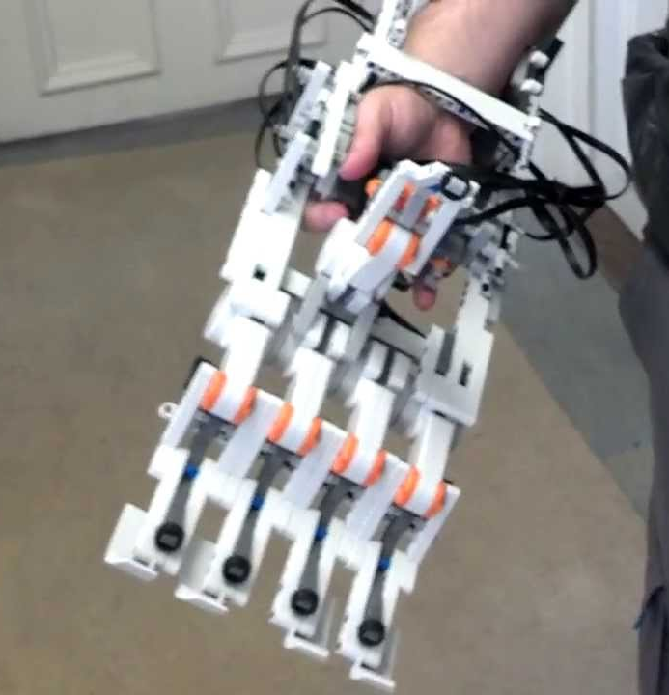
What is a prototype?
Brings designs to life for:
Designers
Users
Allows for exploring ideas
May evolve into final product, or be replaced by an idea that worked better
Is about the presentation of ideas

Slide 13




Why use PowerShell for Prototyping?
Experience
Integration
Cross Platform
Fun

Slide 14
Scenario – Self-Service in Azure Active Directory
Example:
DevOps team request an Azure Resource Group and requestor wants contributor permissions for itself and members on Resource Group.

Slide 15
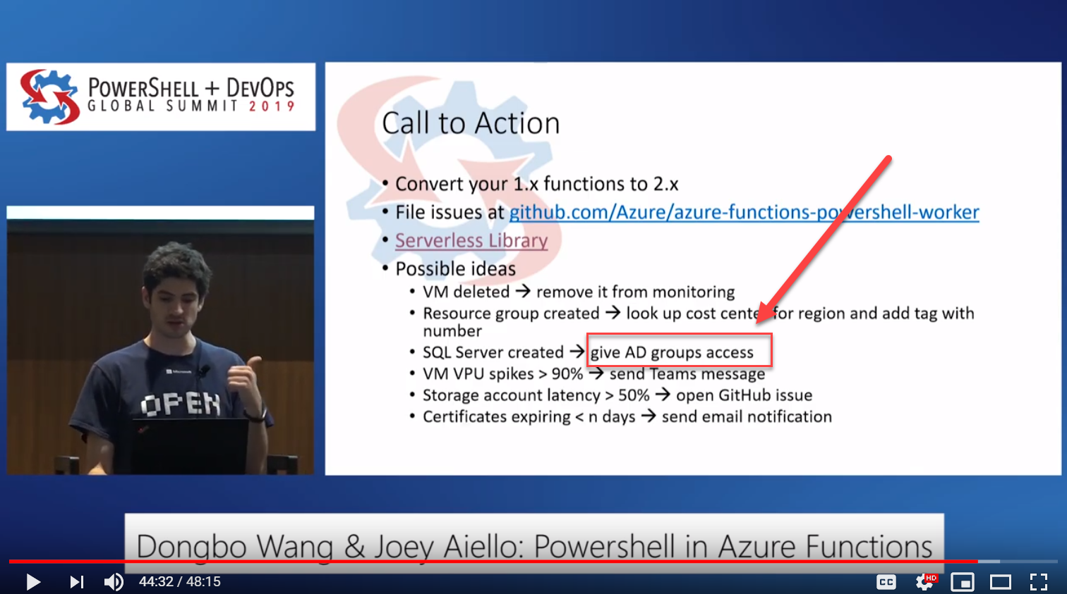

Slide 16
Current process flow
Notes:
IaM = Identity and Access Management

Slide 17
Prototype for Self-Service in AAD
REST API endpoints for AAD Group:
Creating
Retrieving
Removing
Running under context of Service Principal
Leveraging the Graph API

Slide 18
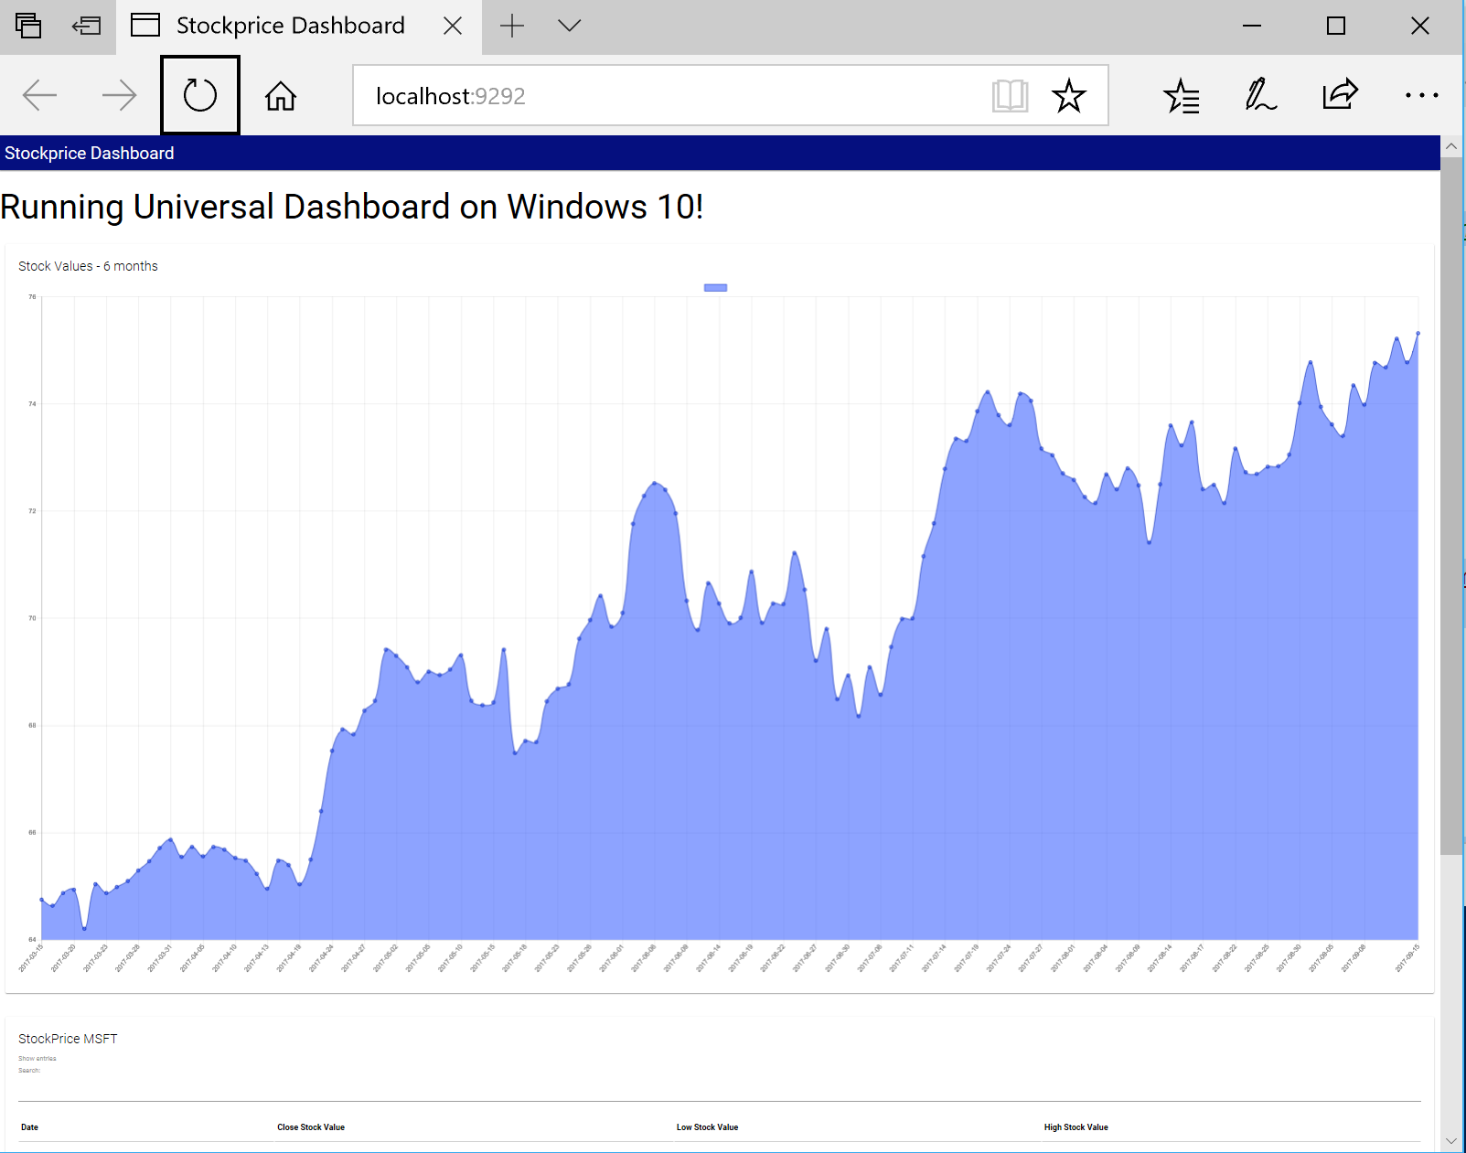

Which Frameworks and Platforms can we use?
Polaris PowerShell Module
Universal Dashboard PowerShell Module
Azure Functions
?...

Slide 19
Polaris
Cross-platform, minimalist web framework for PowerShell
(Install-Module –Name Polaris)
Universal Dashboard
Cross-platform PowerShell module for developing and hosting web-based interactive dashboards.
(Install-Module –Name UniversalDashboard.Community)
Creating REST API’s
Graph API bonus

Slide 20
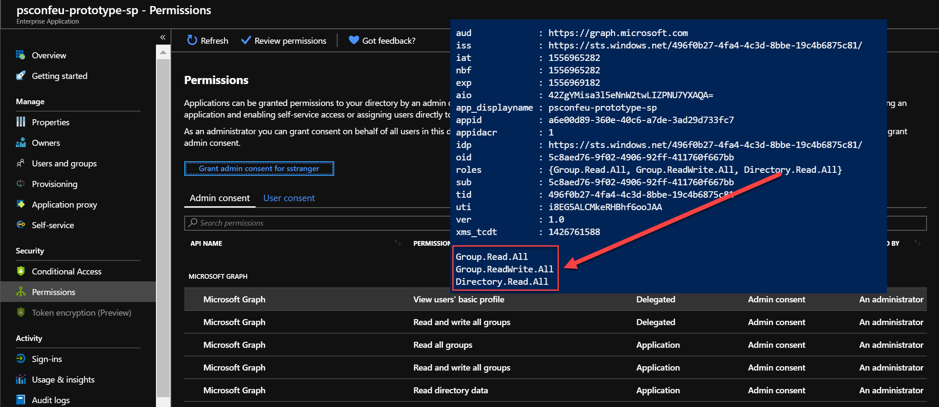
Service Principal – Graph API

Slide 21
Public Preview of PowerShell in Azure Functions 2.x
Azure Functions is an event-based serverless platform
Use the HTTP (webhook) triggers to easily create REST API endpoint
PowerShell Core 6.2 worker
Supports all triggers and bindings
Support for func CLI
Managed Identity and Service Principal support

Slide 22
Azure Functions
ARM Template deployment
ManageAADGroup Module
PowerShell Azure Function
Creating REST API’s

Slide 23
Summary
Explore PowerShell Frameworks and Platform like Azure Functions
PowerShell Modules can easily be used in different Frameworks and Platforms
Notes:
Sum up your key messages

Slide 24
References
Public Preview of PowerShell in Azure Functions 2.x
Create your first PowerShell function in Azure (preview)
Azure Functions PowerShell developer guide
Serverless automation using PowerShell in Azure Functions | Azure Friday
Event-Driven Serverless Containers with PowerShell Azure Functions and Azure Container Instances
Polaris
Universal Dashboard
Pode
Notes:
Sum up your key messages

Slide 25
References
PowerShell Universal Dashboard from Start to Finish (Youtube)
Serverless — from the beginning, using Azure functions ( Azure portal )
PowerShell in Azure Functions by Dongbo Wang & Joey Aiello
Notes:
Sum up your key messages

Slide 26
Notes:
[REQUIRED SLIDE]
Make sure you provide all materials that audience needs to reproduce your demos.
Either upload them as a PowerShell module to www.powershellgallery.com (preferred for reusable functions)
Or, upload them to our github repository (ask the girls at the info desk to provide you with access)
Or, upload them to your own github repository
Please make sure all materials are available by the time your presentation starts, or at minimum upload them right after your presentation

Slide 27
Notes:
[REQUIRED SLIDE]
If you sticked to your timing, you now have 15 min left for Q&A. If you missed your timing, you will have to leave the room when your slot is over. In this case, invite your audience to the coffee break and offer to cover questions there.
IN ANY CASE please point your audience to the conference app and the session voting. By the time the conference opens, the eventraft app *should* have the option to vote on sessions.
Please MAKE SURE you leave your room when your slot is over. The next speaker would like to set him/herself up and get everything up and running.

Slide 28
# Follow these instructions to show perfectly color-coded PowerShell code.
# Paste code to PowerShell ISE, select it, and copy it to the clipboard.
Paste-Code -ToISE | Select-Code | Copy-ToClipboard
# To insert it with full color-coding, paste the code into your slide.
# It will be black, and there is a toolbutton labelled (Ctrl) in PPT.
Click-ToolButton -Choose SymbolWithClipboardAndBrush
# Click the toolbutton, and choose the button that shows a clipboard with a brush.
# This will add color-coding back to the pasted code
PLEASE NOTE: You do not need to use PowerShell ISE to code, or to demo.
Use your preferred editor. With a light theme.
These steps use PowerShell ISE to color-code your code correctly and consistently, and insert the color-coded code into the slide. Please help make all code look consistent. Many thanks!
This is an example of the “Code” layout.
Notes:
To color-code PowerShell code in a consistent way, we ask that you paste your code into PowerShell ISE, select it, and copy it from ISE. Next, paste the code into the text field. It will appear black at first. When you click the small tool button that appears after pasting the code, choose the middle icon with the brush. This adds back the token colors.
Again, use any editor you want during your demos. We ask that you use ISE solely for the purpose of consistently color-coding.
If you use editors other than ISE, make sure you choose a light theme. Dark themes are hard to watch in a presentation room.

Slide 29


about_Speaker
I’m Stefan Stranger
I work at Microsoft as a Consultant
You can find some my open source projects on
Github.
I like to share my knowledge about Azure,
PowerShell and DevOps
Notes:
Do not EVER discuss this slide during your presentation. Please do not take presentation time to talk about yourself more than just a few introductory sentences. Instead, invite interested audience to the coffee break, and then talk about yourself, your job, your services, etc.
Use this slide to sum up your details. It will be part of the conference materials and recorded videos.

